Slide 1
CMSC201
Computer Science I for Majors
Lecture 21 – Project 3 and Miscellaneous Topics

Slide 2
Last Class We Covered
Dictionaries
  Creating
  Accessing
  Manipulating
  Methods
Hashing
Dictionaries vs Lists

Slide 3
Any Questions from Last Time?

Slide 4
Today’s Objectives
To understand more about how data is represented inside the computer
  ASCII values
To see the benefits of short circuit evaluation
To discuss details of Project 3
  Deep copying 2D lists

Slide 5
ASCII Values

Slide 6
ASCII Values
ASCII is how text is represented in computers
  Just like binary is how numbers are represented
In ASCII, every character has a unique, individual numerical code
  Lowercase and uppercase characters are separate
  Codes go from 0 to 127
    Why 127?

Slide 7
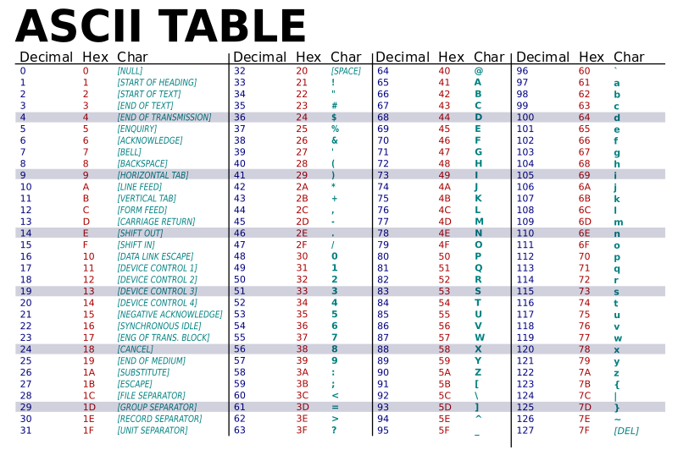

Slide 8
“control” characters
uppercase letters
symbols & numbers
lowercase letters

Slide 9
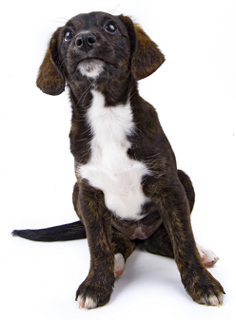
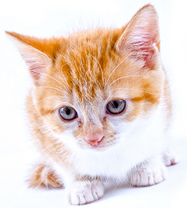
Comparing Strings
The values of the ASCII characters are used when comparing strings together
  Which can lead to some “weird” results
  >>> "cat" < "dog"
  True
  >>> "cat" < "Dog"
  False
  >>> "DOG" < "dog"
  True
?
<

Slide 10
More on Comparing Strings
Gets even more complex when you start adding in numbers and symbols
  >>> "2" < "one"
  True
  >>> "good?" < "good!"
  False
  >>> "UK" < "U.K."
  False

Slide 11
Rules for Comparisons
To avoid (some) of these issues:
Always use .lower() for comparing strings
Pay attention to symbols
  e.g., spaces, hyphens, punctuation, etc.
  Either remove them, or keep
  them in mind as part of the order

Slide 12
ASCII Characters to ASCII Values
We can convert between ASCII characters and their values using ord() and chr()
The ord() function takes in a single character, and returns its ASCII value
The chr() function takes in an integer,
and returns its ASCII character

Slide 13
Using chr() and ord()
  >>> chr(65)
  'A'
  >>> chr(65+32)
  'a'
  >>> ord('?')
  63
  >>> ord("d")
  100
  >>> ord("e")
  101

Slide 14
“Short Circuit” Evaluation

Slide 15
Review: Complex Expressions
We can put multiple operators together!
  bool4 = a and (b or c)
What does Python do first?
  Computes (b or c)
  Computes a and the result
This isn’t strictly true!

Slide 16
Short Circuit Evaluation
Python tries to be efficient (i.e., lazy), and so it won’t do any more work than necessary
  If the remainder of an expression won’t change the outcome, Python doesn’t look at it
This is called “short circuiting”
  It’s a powerful tool, and can simplify the conditionals in your programs

Slide 17
Short Circuit Evaluation – Rules
For obvious reasons, short circuiting behaves differently for and and or statements
“and” statements short circuit as soon as an expression evaluates to False
“or” statements short circuit as soon as an expression evaluates to True

Slide 18
Short Circuiting – and
Notice that in the expression:
  bool1 = a and (b or c)
If a is False
The rest of the expression doesn’t matter
Python will realize this, and if a is False won’t bother with the rest of the expression

Slide 19
Short Circuiting – or
Notice that in the expression:
  bool1 = a or (b or c)
If a is True
The rest of the expression doesn’t matter
Python will realize this, and if a is True
won’t bother with the rest of the expression

Slide 20
Causing Errors
This can lead to “new” errors in old code
  >>> a = True
  >>> # Variables b and c not defined
  >>> a or (b and c)
  True
  >>> a = False
  >>> a or (b and c)
  Traceback (most recent call last):
  File "<stdin>", line 1, in <module>
  NameError: name 'b' is not defined
Python stopped at the “or”, so it never saw b or c

Slide 21
Simplifying Conditionals
Order matters! You can use short circuiting to control what statements are reached
While checking the validity of input, if
the user can also enter a “Q” to quit
  if num != QUIT and int(num) > MIN_VAL:
  return num
This will only be reached if num is not “Q”, so the cast to int() won’t cause a problem

Slide 22
Project 3

Slide 23
Do Not Cheat on Project 3
Yes, this project has been given before
  Yes, in this class
  Yes, we have all of the old projects to compare it to
Yes, this project has solutions on the internet
  Yes, we have copies of all of them
  Yes, we will go looking for new ones after it’s due
Yes, you could pay someone else to do it
  Yes, we know of the sites where you can get this done
  Yes, we will spot “elegant” code that you didn’t write

Slide 24
Deep Copying 2D Lists
Why does this have to happen?
  The path needs to be deep copied, so that it doesn’t have any dead ends or backtracking in it
  newPath = []
  for i in range(len(path)):
  innerCopy = list( path[i] )
  newPath.append( innerCopy)

Slide 25
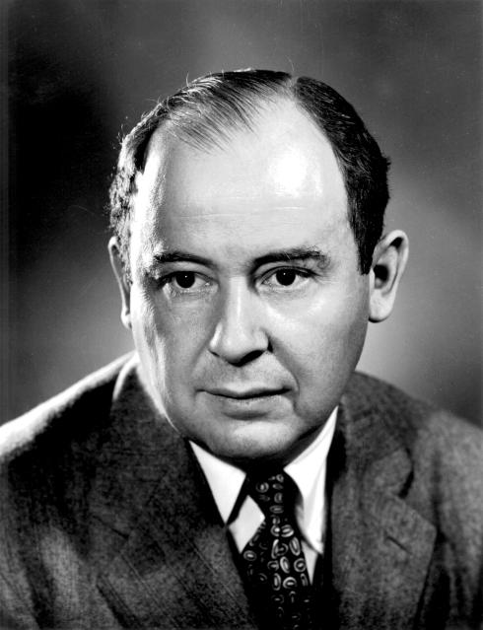
Daily CS History
John von Neumann
  Creator of merge sort
    We’ll learn this soon!
  Helped develop what is now
  known as “von Neumann
  architecture” (not all his work)
  Created a rigorous framework
  for quantum mechanics
  Developed implosion mechanism
  for nuclear bombs

Slide 26
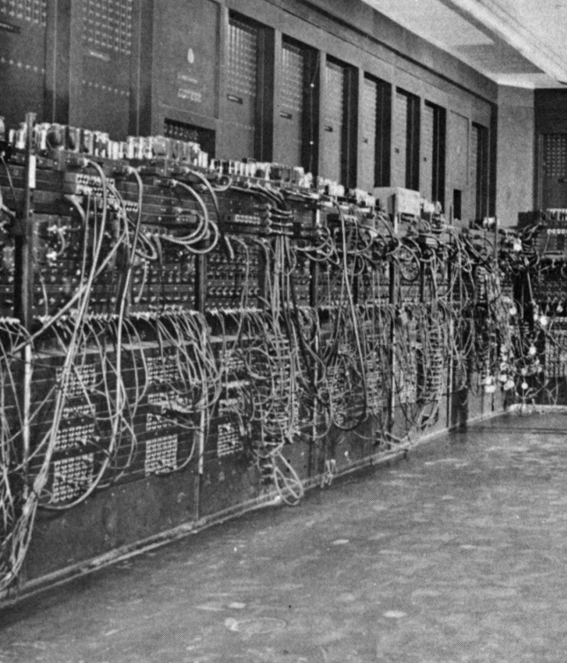
More Daily CS History
ENIAC
  Completed in 1946 at UPenn
    Decommissioned in 1956
  Computations were 2,400
  times faster than humans
  Cost $6.7 million to build
  Meant to create artillery
  firing tables for the US Army
  Also used for studying thermonuclear feasibility

Slide 27
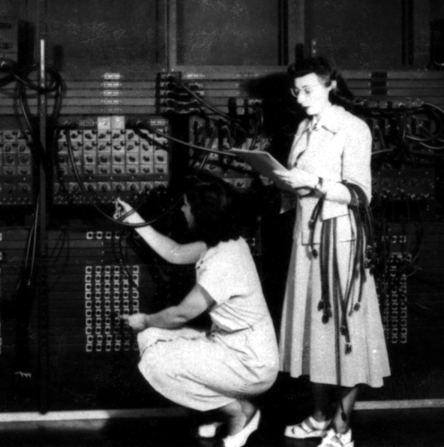

Even More Daily CS History
ENIAC Programmers
  Kay McNulty, Betty Jennings, Betty Snyder, Marlyn Meltzer, Fran Bilas, and Ruth Lichterman
  These women turned abstract
  ideas into working, bug-free code
    First program run on ENIAC had
    a million individual punchcards
  Programming was seen back then
  as “easy” work, akin to typing up
  a handwritten letter

Slide 28
Announcements
Project 3 is due on Friday, December 8th
  Design due on Friday, December 1st
Survey #3 out on Friday, December 1st
  Final exam metacognition quiz out on BB same day
Exam wrappers handed back this week in lab
Final exam is when?
Friday, December 15th from 6 to 8 PM

Slide 29
Final Exam Locations
Find your room ahead of time!
ITE Building 102 - Sections 22, 28, 32
ITE Building 104 - Sections 2, 3, 4, 5, 6
Meyerhoff 030 - Sections 8, 9, 10, 11, 12, 14, 17, 18, 20
Performing Arts 132 - Sections 15, 16, 31
Sherman 003 - Sections 23, 26, 29, 30
Public Policy 105 - Sections 21, 24, 27

Slide 30
Image Sources
ASCII table (adapted from):
  https://commons.wikimedia.org/wiki/File:ASCII-Table-wide.svg
Generic kitten:
  http://www.publicdomainpictures.net/view-image.php?image=87454
Generic puppy:
  http://www.publicdomainpictures.net/view-image.php?image=192231
John von Neumann:
  https://en.wikipedia.org/wiki/File:JohnvonNeumann-LosAlamos.gif
ENIAC (adapted from):
  https://commons.wikimedia.org/wiki/File:Eniac.jpg
ENIAC programmers (adapted from):
  https://commons.wikimedia.org/wiki/File:Reprogramming_ENIAC.png
Mad emoji (adapted from):
  https://commons.wikimedia.org/wiki/File:Twemoji_1f620.svg

